Slide 1
CS101 Algorithms and Data Structures
Divide and Conquer
Textbook Ch 1.4
Notes:
Adapted from the slides by Douglas Wilhelm Harder of U Waterloo (https://ece.uwaterloo.ca/~dwharder/aads/Lecture_materials/)
May also contain material from the slides at https://courses.cs.washington.edu/courses/cse326/03wi/326lecturesb.shtml (by Dan Suciu of U Wash

Slide 2
Outline
Master Theorem
Integer Multiplication
Matrix Multiplication
Convolution and FFT
Notes:
https://zhuanlan.zhihu.com/p/100531135

Slide 3
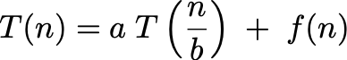
Master Theorem
Goal. Recipe for solving common divide-and-conquer recurrences: with T(0) = 0 and T(1) = Θ(1).
Terms.
a ≥ 1 is the number of subproblems.
b ≥ 2 is the factor by which the subproblem size decreases.
f (n) ≥ 0 is the work to divide and combine subproblems.
Recursion tree. [ assuming n is a power of b ]
a = branching factor.
a^{k} = number of subproblems at level k.
1 + log_{b} n levels.
n / b^{k} = size of subproblem at level k.

Slide 4
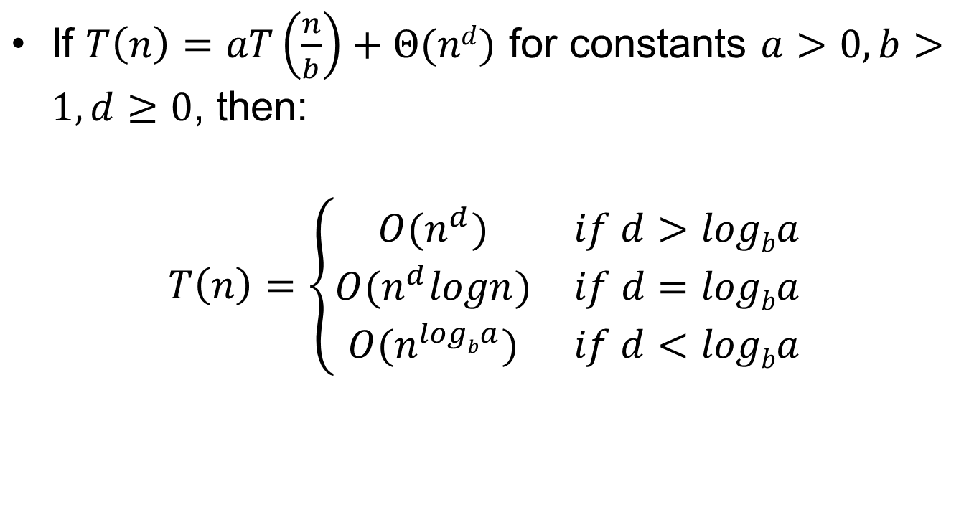
Master Theorem
If $T\left(n\right)=aT\left(\frac{n}{b}\right)+Θ(nd)$ for constants $a>0, b>1, d≥0$, then:
$$T\left(n\right)=\left\{\begin{matrix}O(n^{d}) & if d>logba \\ O(n^{d}logn) & if d=logba \\ O(n^{logba}) & if d<logba\end{matrix}\right.$$
Notes:
最后的公式是一个累加函数
一看结构，是一个等比数列，公比为
等比数列的求和公式为
其实分析时间复杂度，比较简单，对于等比数列来说，如果公比q<1, 那么第一项最大，其他项会依次减少，最终的时间复杂度就是
因为其他项最终相加也不会大于是常数倍的首项--时间复杂度的定义
第一种情况所以，当公比
的时候，整个算法的时间复杂度由第一项决定，
第二种情况而如果反过来，公比q>1, 那么最后一项最大，最终的时间复杂度由最后一项 统治（dominate）
整个算法的时间复杂度由最后一项决定

Slide 5
Outline
Master Theorem
Integer Multiplication
Matrix Multiplication
Convolution and FFT
Notes:
https://zhuanlan.zhihu.com/p/100531135

Slide 6
Integer addition and subtraction
Addition. Given two n-bit integers x and y, compute x + y.
Subtraction. Given two n-bit integers x and y, compute x – y.
Grade-school algorithm. Θ(n) bit operations.
Remark. Grade-school addition and subtraction algorithms are optimal.
 | 1 | 1 | 1 | 1 | 1 | 1 | 0 | 1
 |  | 1 | 1 | 0 | 1 | 0 | 1 | 0 | 1
 | + | 0 | 1 | 1 | 1 | 1 | 1 | 0 | 1
 | 1 | 0 | 1 | 0 | 1 | 0 | 0 | 1 | 0
Notes:
避免最坏情形的策略，

Slide 7
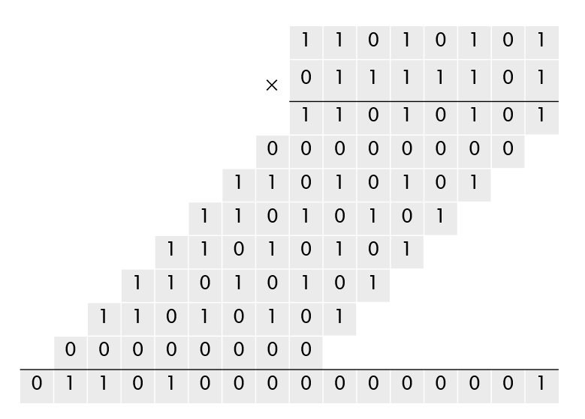
Integer multiplication
Multiplication. Given two n-bit integers x and y, compute x × y.
Grade-school algorithm (long multiplication). Θ(n²) bit operations.
Notes:
Heap 和merge 都是nlogn

Slide 8
Divide-and-conquer multiplication
To multiply two n-bit integers x and y:
Divide x and y into low- and high-order bits.
Multiply four ½n-bit integers, recursively.
Add and shift to obtain result.
n
n
x =
y =
a
b
c
d
m=n/2
m=n/2
m=n/2
m=n/2
Then
x y = (2^{m} a + b) (2^{m} c + d) = 2^{2m} ac + 2^{m} (bc + ad) + bd
1
2
3
4
Ex. x = 10001101 y = 11100001
a
b
c
d

Slide 9
Multiply(x, y, n) _______________________________________________________________________________________________________________________________________________________________________________________________________________________________________________________________________________________________________________________________________________________________________________________________________________________________________________________________________________________________________________________________________________________________________________________________________________________________________________________________________________________________________________________________________________________________________________________________________________________________________________________
If (n = 1)
Return x y.
Else
m ← ⎡ n / 2 ⎤.
a ← ⎣ x / 2^{m} ⎦; b ← x mod 2^{m}.
c ← ⎣ y / 2^{m} ⎦; d ← y mod 2^{m}.
e ← Multiply(a, c, m).
f ← Multiply(b, d, m).
g ← Multiply(b, c, m).
h ← Multiply(a, d, m).
Return 2^{2m} e + 2^{m} (g + h) + f.
_______________________________________________________________________________________________________________________________________________________________________________________________________________________________________________________________________________________________________________________________________________________________________________________________________________________________________________________________________________________________________________________________________________________________________________________________________________________________________________________________________________________________________________________________________________________________________________________________________________________________________________________
Θ(n)
4 T(⎡n / 2⎤)
Θ(n)

Slide 10
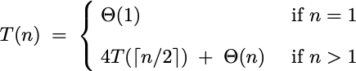
Question 1
How many bit operations to multiply two n-bit integers using the divide-and-conquer multiplication algorithm?
A. T(n) = Θ(n^{1/2}).
B. T(n) = Θ(n log n).
C. T(n) = Θ(n^{log23}) = O(n^{1.585}).
D. T(n) = Θ(n²).

Slide 11
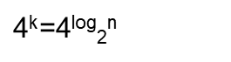
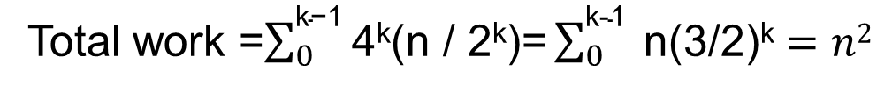
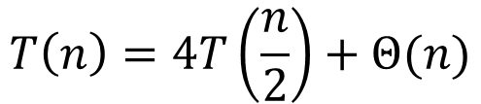
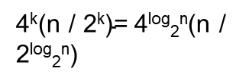
Recursion Tree for Integer Multiplication
Level
Problem #
Problem size
Work
0
1
n
n
1
4
(n/2)
4(n/2)
2
. . .
. . .
. . .
. . .
4²
(n/4)
4²(n/4)
4
4
4
4
. . .
. . .
. . .
. . .
. . .
k=log₂n
. . . . . .
$\text{4}\text{k}$=4^{log}₂^{n}
1
$\text{4}\text{k}\text{(}\text{n}\text{ / 2}\text{k}\text{)=}$4^{log}₂^{n}(n / 2^{log}₂^{n})
$$T\left(n\right)=4T\left(\frac{n}{2}\right)+Θ(n)$$
Total work =$\sum_{0}^{\text{k}\text{−1}}{\text{4}\text{k}\text{(}\text{n}\text{ / 2}\text{k}\text{)}\text{=}\sum_{0}^{\text{k}\text{−1}}{ \text{n}\text{(3/}\text{2}\text{)}\text{k}}}=n2$

Slide 12
Karatsuba trick
To multiply two n-bit integers x and y:
Divide x and y into low- and high-order bits.
To compute middle term bc + ad, use identity:
Multiply only three ½n-bit integers, recursively.
bc + ad = ac + bd – (a – b) (c – d)
x y = (2^{m} a + b) (2^{m} c + d) = 2^{2m} ac + 2^{m} (bc + ad) + bd
1
2
3
4
Notes:
选了44，前面小，后面大，那么44现在在正确的位置上

Slide 13
Divide-and-conquer multiplication
To multiply two n-bit integers x and y:
Divide x and y into low- and high-order bits.
Multiply four ½n-bit integers, recursively.
Add and shift to obtain result.
n
n
x =
y =
a
b
c
d
Then
m=n/2
m=n/2
m=n/2
m=n/2
x y = (2^{m} a + b) (2^{m} c + d) = 2^{2m} ac + 2^{m} (bc + ad) + bd
1
2
3
4
= 2^{2m} ac + 2^{m} (ac + bd – (a – b)(c – d)) + bd
1
1
2
3
2

Slide 14
Karatsuba-Multiply(x, y, n) _______________________________________________________________________________________________________________________________________________________________________________________________________________________________________________________________________________________________________________________________________________________________________________________________________________________________________________________________________________________________________________________________________________________________________________________________________________________________________________________________________________________________________________________________________________________________________________________________________________________________________________________
If (n = 1)
Return x y.
Else
m ← ⎡ n / 2 ⎤.
a ← ⎣ x / 2^{m} ⎦; b ← x mod 2^{m}.
c ← ⎣ y / 2^{m} ⎦; d ← y mod 2^{m}.
e ← Karatsuba-Multiply(a, c, m).
f ← Karatsuba-Multiply(b, d, m).
g ← Karatsuba-Multiply(⎢a – b⎢, ⎢c – d⎢, m).
Flip sign of g if needed.
Return 2^{2m} e + 2^{m} (e + f – g) + f.
_____________________________________________________________________________________________________________________________________________________________________________________________________________________________________________________________________
Θ(n)
3 T(⎡n / 2⎤)
Θ(n)

Slide 15
Question 2
How many bit operations to multiply two n-bit integers using the divide-and-conquer multiplication algorithm?
A. T(n) = Θ(n^{1/2}).
B. T(n) = Θ(n log n).
C. T(n) = Θ(n^{log23}) = O(n^{1.585}).
D. T(n) = Θ(n²).
3

Slide 16
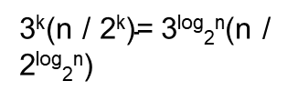
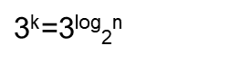
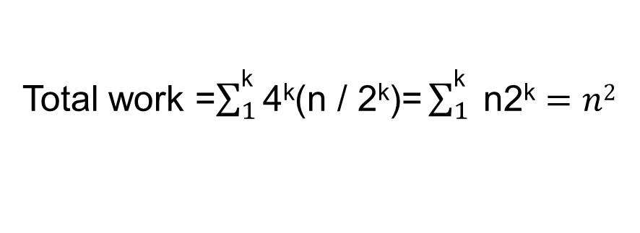
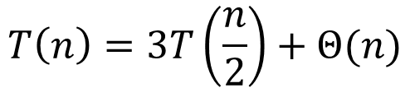
Recursion Tree for Integer Multiplication
Level
Problem #
Work
Problem #
Problem size
Work
1
n
0
1
n
n
3
4(n/2)
1
4
(n/2)
3(n/2)
3²
4²(n/4)
2
. . .
. . .
. . .
. . .
4²
(n/4)
3²(n/4)
4
4
4
4
3
3
3
3
. . .
. . .
. . .
. . .
. . .
. . .
. . .
k=log₂n
. . . . . .
$\text{3}\text{k}$=3^{log}₂^{n}
$\text{4}\text{k}$=4^{log}₂^{n}
1
$\text{4}\text{k}\text{(}\text{n}\text{ / 2}\text{k}\text{)=}$4^{log}₂^{n}(n / 2^{log}₂^{n})
$\text{3}\text{k}\text{(}\text{n}\text{ / 2}\text{k}\text{)=}$3^{log}₂^{n}(n / 2^{log}₂^{n})
$$T\left(n\right)=3T\left(\frac{n}{2}\right)+Θ(n)$$
$$T\left(n\right)=4T\left(\frac{n}{2}\right)+Θ(n)$$
Total work =$\sum_{0}^{\text{k}\text{−1}}{\text{4}\text{k}\text{(}\text{n}\text{ / 2}\text{k}\text{)}\text{=}\sum_{0}^{\text{k}\text{−1}}{ \text{n}\text{(3/}\text{2}\text{)}\text{k}}}=n^{\log_{2}3}=n^{1.585}$
Total work =$\sum_{1}^{\text{k}}{\text{4}\text{k}\text{(}\text{n}\text{ / 2}\text{k}\text{)}\text{=}\sum_{1}^{\text{k}}{ \text{n}\text{2}\text{k}}}=n2$

Slide 17
Outline
Master Theorem
Integer Multiplication
Matrix Multiplication
Convolution and FFT
Notes:
https://zhuanlan.zhihu.com/p/100531135

Slide 18
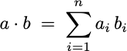
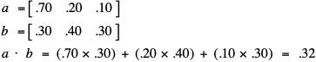
Dot product
Dot product. Given two length-n vectors a and b, compute c = a ⋅ b.
Grade-school. Θ(n) arithmetic operations.

Slide 19
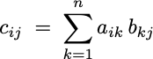
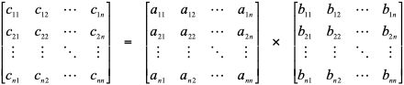
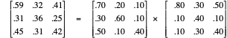
Matrix multiplication
Matrix multiplication.
Given two n-by-n matrices A and B, compute C = AB.
Θ(n³) arithmetic operations.
Notes:
Worst case：每一次都选最小的做pivot，复杂度n方

Slide 20
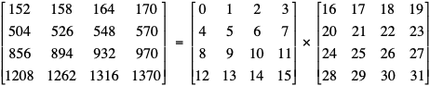
Block matrix multiplication
A₁₁
A₁₂
B₁₁
C₁₁
B₂₁
Notes:
最好就是每次选中位数

Slide 21
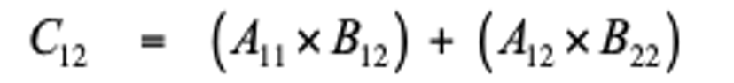
Block matrix multiplication
A₁₁
A₁₂
B₂₁
C₁₂
B₂₂
B₂₂
Notes:
最好就是每次选中位数

Slide 22
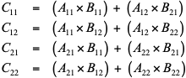
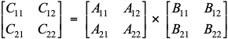
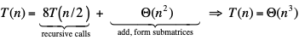
Block matrix multiplication: warmup
To multiply two n-by-n matrices A and B:
Divide: partition A and B into ½n-by-½n blocks.
Conquer: multiply 8 pairs of ½n-by-½n matrices, recursively.
Combine: add appropriate products using 4 matrix additions.
8 matrix multiplications
(of ½n-by-½n matrices)
n-by-n matrices
½n-by-½n matrices
4 matrix additions
(of ½n-by-½n matrices)
Notes:
为了坑小，选三个位置的中位数

Slide 23
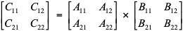
Strassen’s trick
Key idea. Can multiply two 2-by-2 matrices via 7 scalar multiplications (plus 11 additions and 7 subtractions).
P1 ← A11 (B12 – B22)
P2 ← (A11 + A12) B22
P3 ← (A21 + A22) B11
P4 ← A22 (B21 – B11)
P5 ← (A11 + A22) (B11 + B22)
P6 ← (A12 – A22) (B21 + B22)
P7 ← (A11 – A21) (B11 + B12)
scalars
C11 = P5 + P4 – P2 + P6
C12 = P1 + P2
C21 = P3 + P4
C22 = P1 + P5 – P3 – P7
7 scalar multiplications

Slide 24
Strassen’s trick
n-by-n
½n-by-½n matrix
Key idea. Can multiply two 2-by-2 matrices via 7 scalar multiplications (plus 11 additions and 7 subtractions).
P1 ← A11 (B12 – B22)
P2 ← (A11 + A12) B22
P3 ← (A21 + A22) B11
P4 ← A22 (B21 – B11)
P5 ← (A11 + A22) (B11 + B22)
P6 ← (A12 – A22) (B21 + B22)
P7 ← (A11 – A21) (B11 + B12)
scalars
C11 = P5 + P4 – P2 + P6
C12 = P1 + P2
C21 = P3 + P4
C22 = P1 + P5 – P3 – P7
7 scalar multiplications

Slide 25
assume n is a power of 2
Strassen(n, A, B)
If (n = 1) Return A B.
Partition A and B into ½n-by-½n blocks.
P1 ← Strassen(n / 2, A11, (B12 – B22)).
P2 ← Strassen(n / 2, (A11 + A12), B22).
P3 ← Strassen(n / 2, (A21 + A22), B11).
P4 ← Strassen(n / 2, A22, (B21 – B11)).
P5 ← Strassen(n / 2, (A11 + A22), (B11 + B22)).
P6 ← Strassen(n / 2, (A12 – A22), (B21 + B22)).
P7 ← Strassen(n / 2, (A11 – A21), (B11 + B12)).
C11 = P5 + P4 – P2 + P6.
C12 = P1 + P2.
C21 = P3 + P4.
C22 = P1 + P5 – P3 – P7.
Return C.
7 T(n / 2) + Θ(n²)
Θ(n²)
Notes:
We ½ to choose the first half nodes and then on avg we will separate the half into anther half, the same separation happens if we choose one item from the second half.

Slide 26
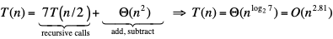
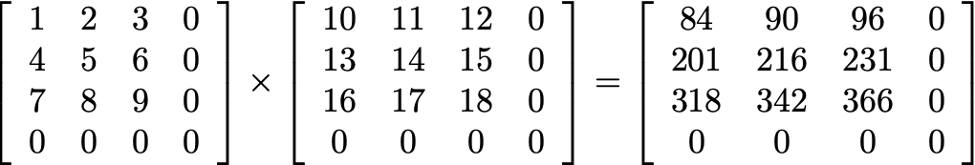
Analysis of Strassen’s algorithm
Theorem. Strassen’s algorithm requires O(n^{2.81}) arithmetic operations to multiply two n-by-n matrices.
Pf.
When n is a power of 2, apply Case 1 of the master theorem:
When n is not a power of 2, pad matrices with zeros to be n′-by-n′, where n ≤ n′ < 2n and n′ is a power of 2.

Slide 27
Strassen’s algorithm: practice
Implementation issues.
Sparsity.
Caching.
n not a power of 2.
Numerical stability.
Non-square matrices.
Storage for intermediate submatrices.
Crossover to classical algorithm when n is “small.”
Parallelism for multi-core and many-core architectures.
Common misperception. “Strassen’s algorithm is only a theoretical curiosity.”
Apple reports 8x speedup when n ≈ 2,048.
Range of instances where it’s useful is a subject of controversy.

Slide 28
Question 3
Suppose that you could multiply two 3-by-3 matrices with 21 scalar multiplications. How fast could you multiply two n-by-n matrices?
A. Θ(n^{log321})
B. Θ(n^{log221})
C. Θ(n^{log921})
D. Θ(n²)

Slide 29
Question 4
Is it possible to multiply two 3-by-3 matrices using only 21 scalar multiplications?
A. Yes.
B. No.
C. Unknown.

Slide 30
Fast matrix multiplication: theory
Q. Multiply two 2-by-2 matrices with 7 scalar multiplications?
A. Yes! [Strassen 1969] Θ(n^{log27}) = O(n^{2.81})
Q. Multiply two 2-by-2 matrices with 6 scalar multiplications?
A. Impossible. [Hopcroft–Kerr, Winograd 1971] Θ(n^{log26}) = O(n^{2.59})
Begun, the decimal wars have. [Pan 1978, Bini et al., Schönhage, …]
Two 70-by-70 matrices with 143,640 scalar multiplications. O(n^{2.7962})
Two 48-by-48 matrices with 47,217 scalar multiplications. O(n^{2.7801})
A year later. O(n^{2.7799})
December 1979. O(n^{2.521813})
January 1980. O(n^{2.521801})

Slide 31
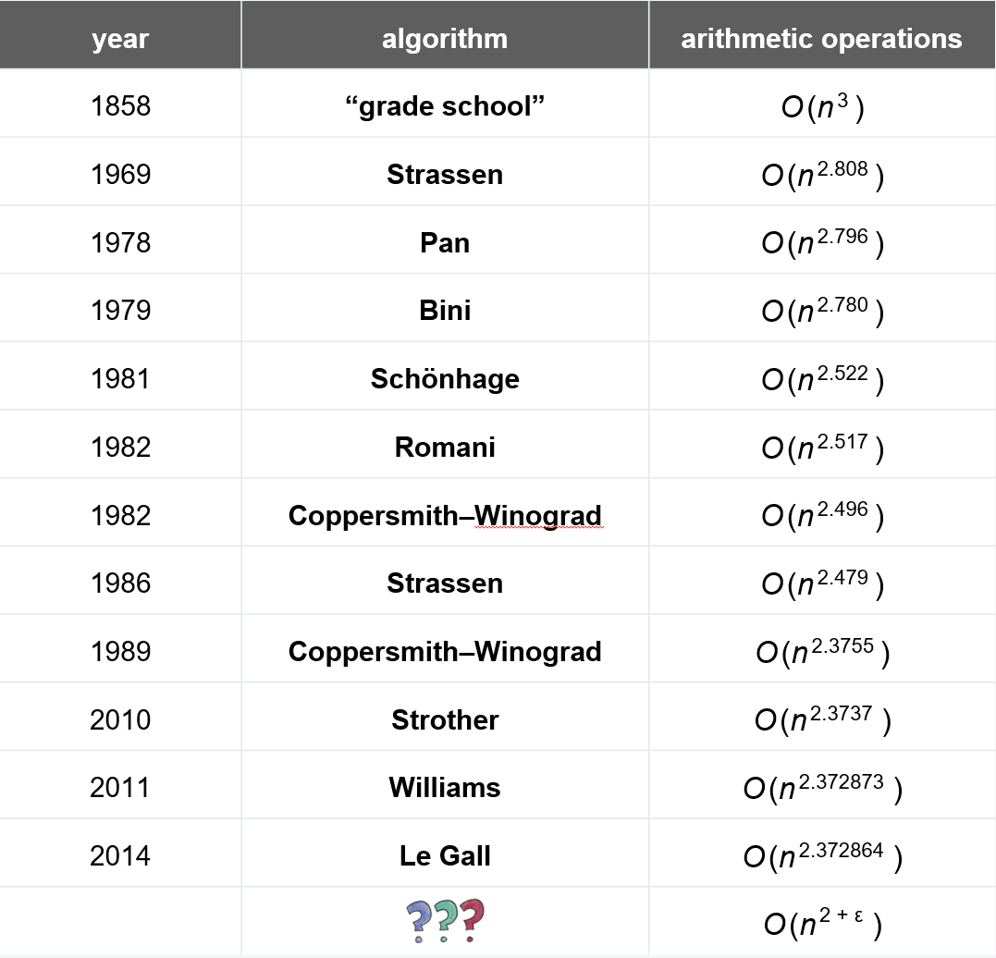
History of arithmetic complexity of matrix multiplication
Galactic
algoithms
Number of arithmetic operations to multiply two n-by-n matrices.

Slide 32
Outline
Master Theorem
Integer Multiplication
Matrix Multiplication
Convolution and FFT
Notes:
https://zhuanlan.zhihu.com/p/100531135

Slide 33
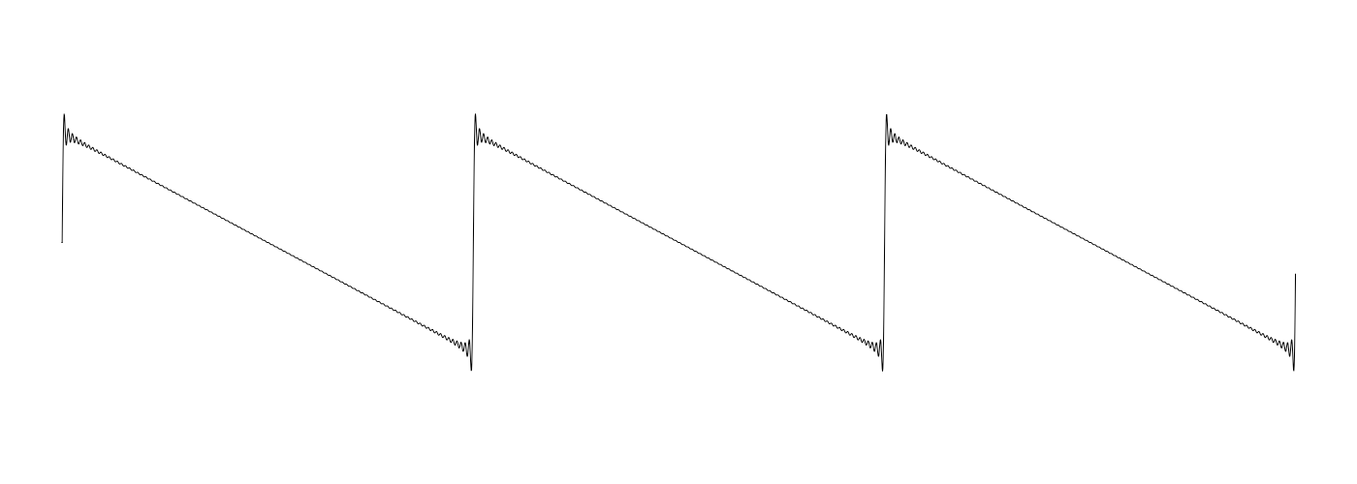
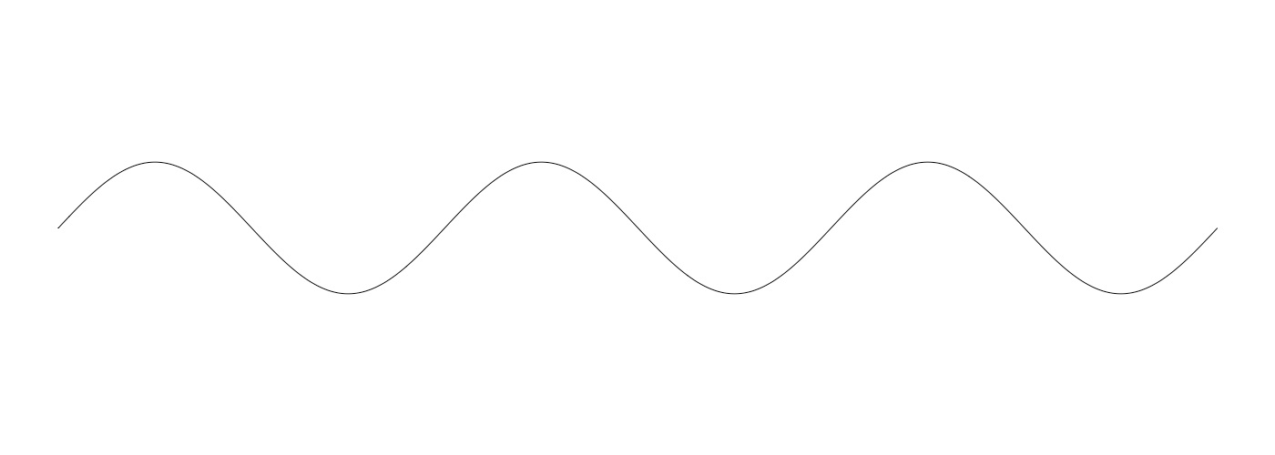
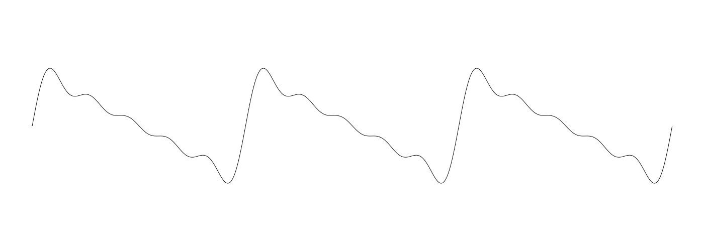
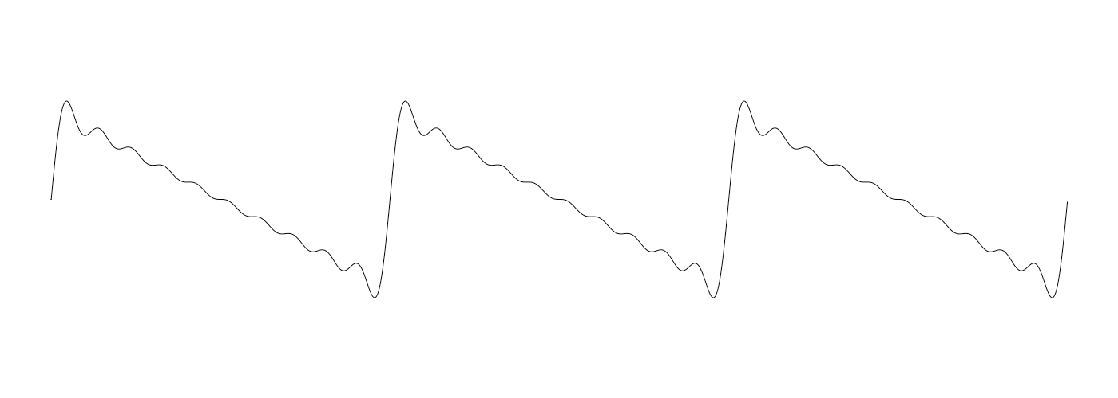
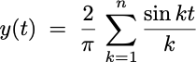
Outline
Fourier theorem. [Fourier, Dirichlet, Riemann] Any (sufficiently smooth) periodic function can be expressed as the sum of a series of sinusoids.
n = 1
t
n = 5
n = 10
n = 100

Slide 34
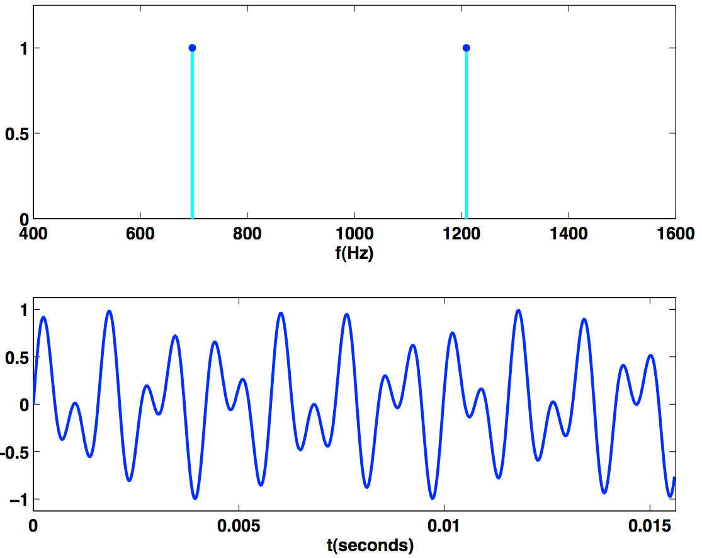
Time domain vs. frequency domain
Signal. [touch tone button 1]
Time domain.
Frequency domain.
sound
pressure
0.5
amplitude
Reference: Cleve Moler, Numerical Computing with MATLAB

Slide 35
Fast Fourier Transform (FFT)
FFT. Fast way to convert between time domain and frequency domain.
Alternate viewpoint. Fast way to multiply and evaluate polynomials.
we take this approach

Slide 36
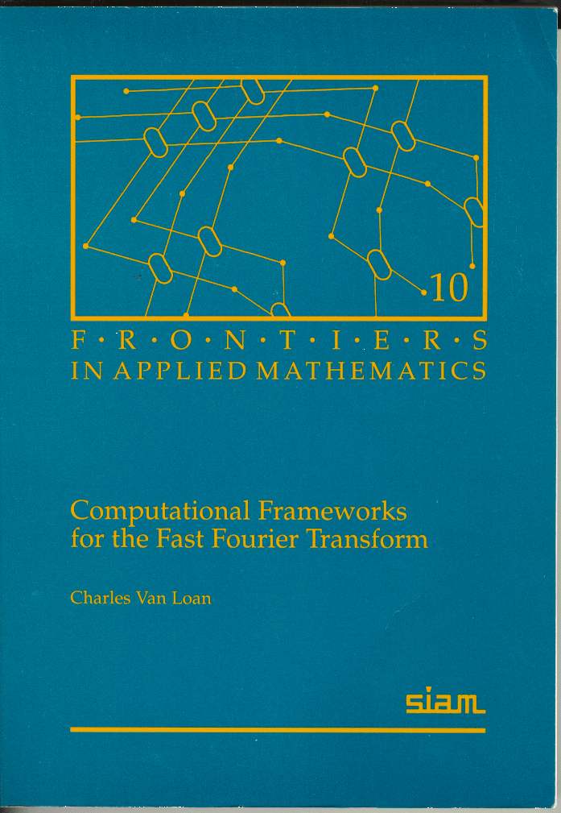
Fast Fourier transform: applications
Applications.
Optics, acoustics, quantum physics, telecommunications, radar, control systems, signal processing, speech recognition, data compression, image processing, seismology, mass spectrometry, …
Digital media. [DVD, JPEG, MP3, H.264]
Medical diagnostics. [MRI, CT, PET scans, ultrasound]
Numerical solutions to Poisson’s equation.
Integer and polynomial multiplication.
Shor’s quantum factoring algorithm.
“ The FFT is one of the truly great computational developments of [the 20th] century. It has changed the face of science and engineering so much that it is not an exaggeration to say that life as we know it would be very different without the FFT. ” — Charles van Loan

Slide 37
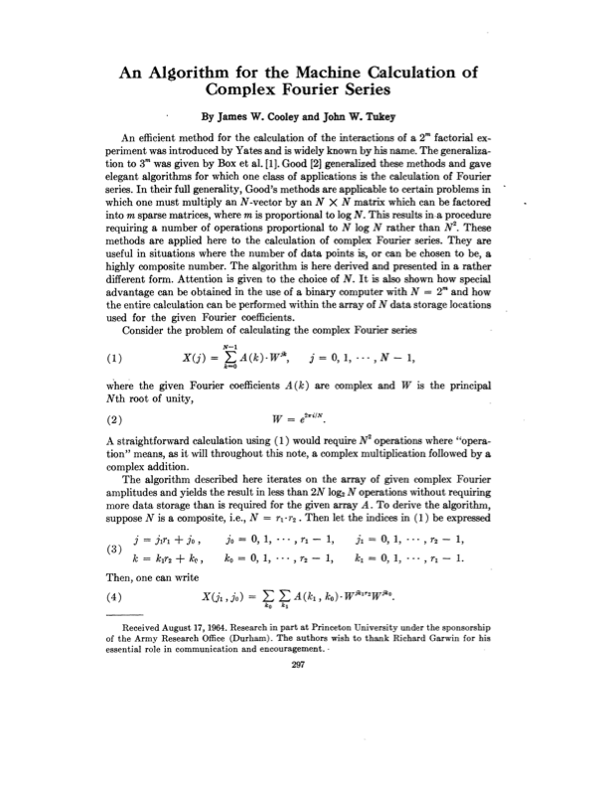
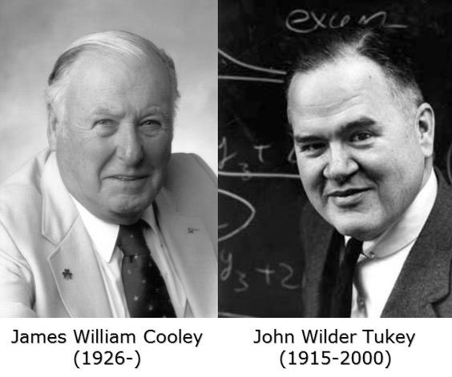
Fast Fourier transform: brief history
Gauss (1805, 1866). Analyzed periodic motion of asteroid Ceres.
Runge–König (1924). Laid theoretical groundwork.
Danielson–Lanczos (1942). Efficient algorithm, x-ray crystallography.
Cooley–Tukey (1965). Detect nuclear tests in Soviet Union and track submarines. Rediscovered and popularized FFT.
Importance not fully realized until emergence of digital computers.

Slide 38
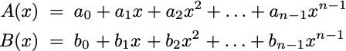
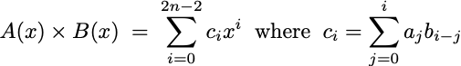
Polynomials: coefficient representation
Univariate polynomial. [ coefficient representation ]
Addition. O(n) arithmetic operations.
Evaluation. O(n) using Horner’s method.
Multiplication (linear convolution). O(n²) using brute force.

Slide 39
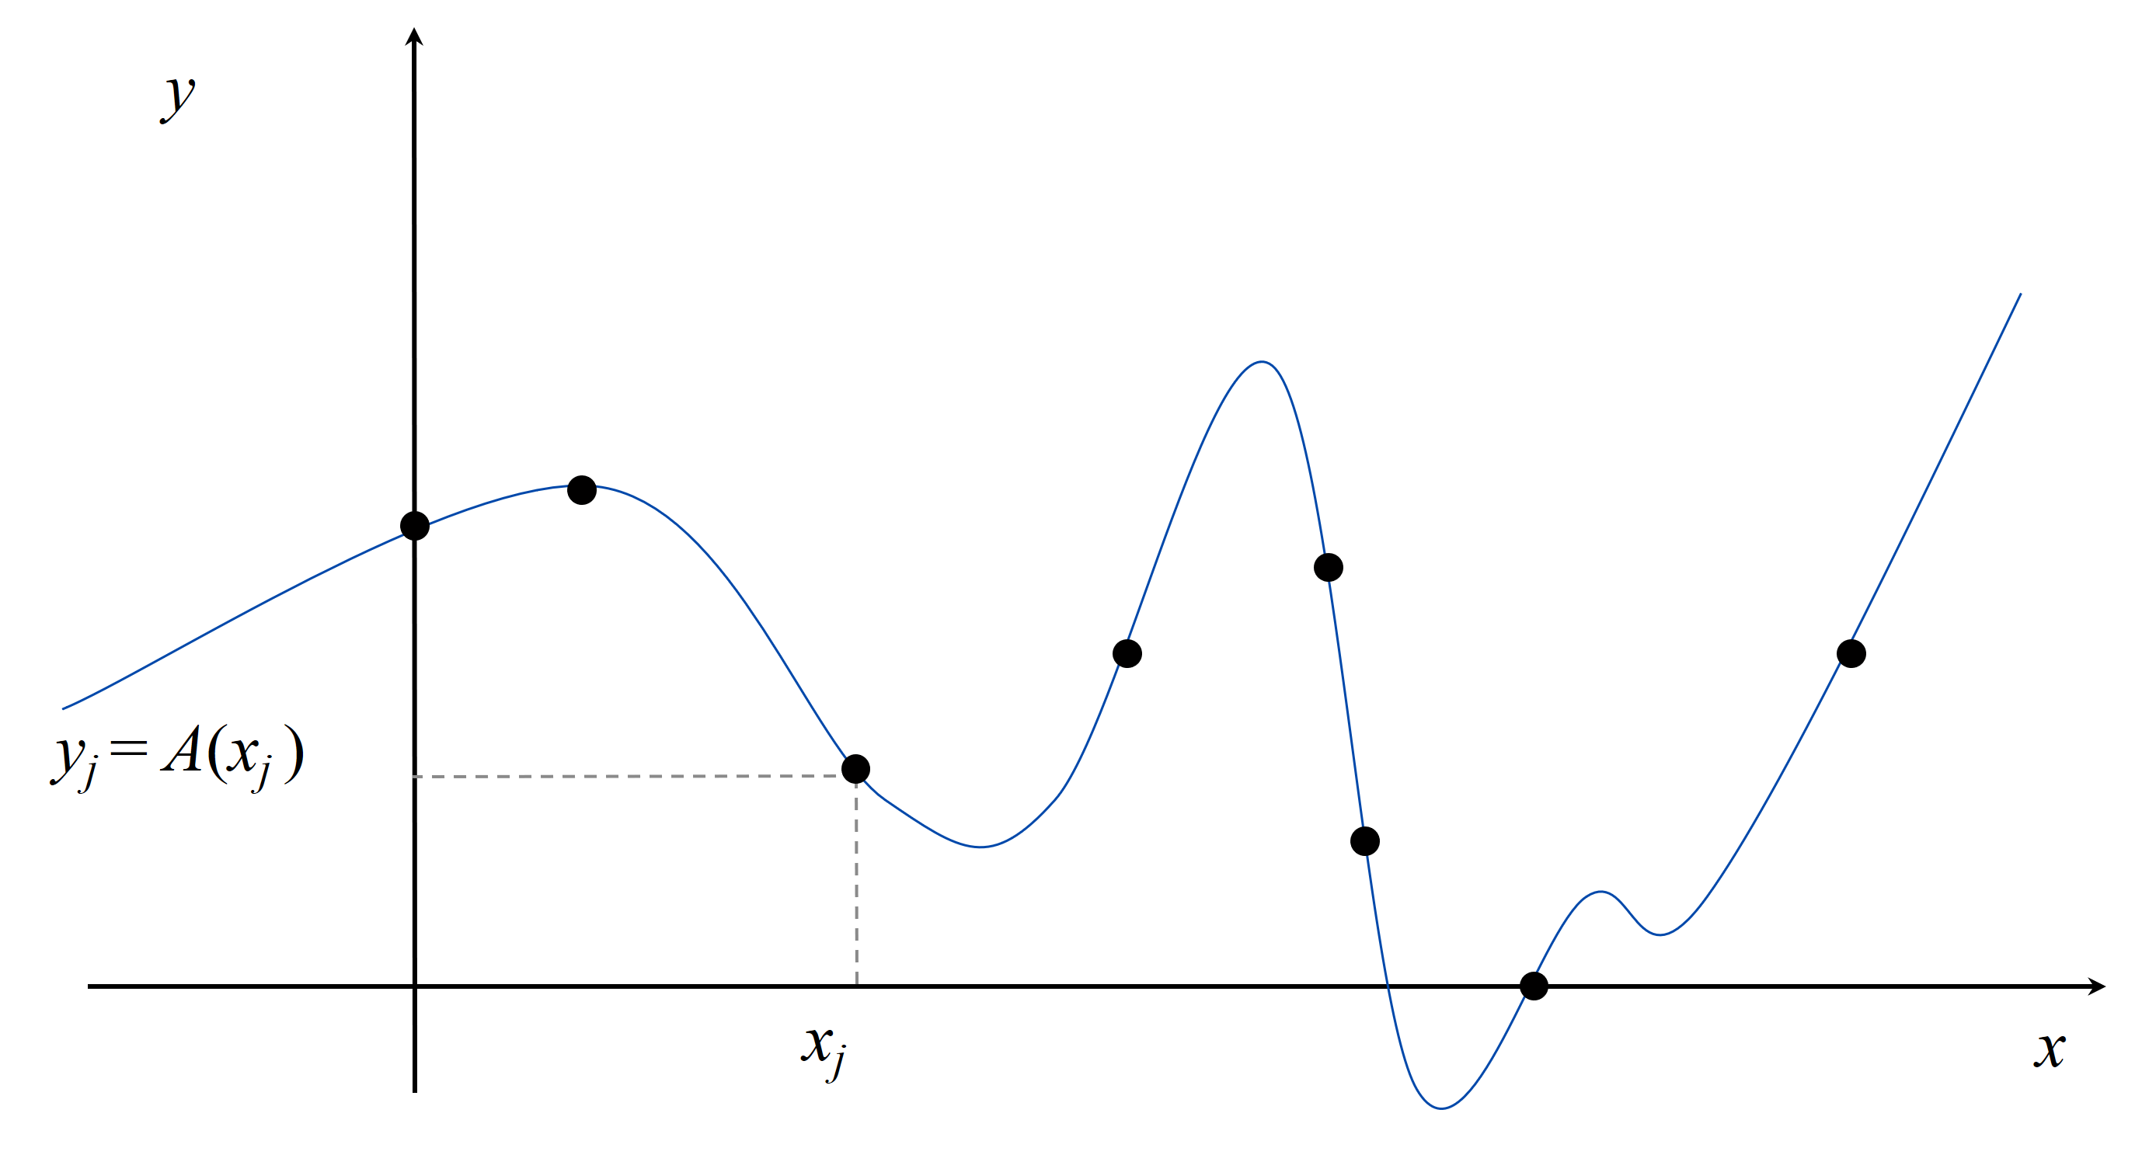
Polynomials: point-value representation
Fundamental theorem of algebra. A degree n univariate polynomial with complex coefficients has exactly n complex roots.
Corollary. A degree n – 1 univariate polynomial A(x) is uniquely specified by its evaluation at n distinct values of x.

Slide 40
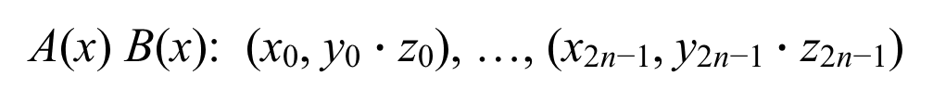
Polynomials: point-value representation
Univariate polynomial. [ point-value representation ]
Addition. O(n) arithmetic operations.
Multiplication. O(n), but represent A(x) and B(x) using 2n points.
A(x): (x₀, y₀), …, (x_{n−1}, y_{n−1})
B(x): (x₀, z₀), …, (x_{n−1}, z_{n−1})
A(x) + B(x): (x₀, y₀ + z₀), …, (x_{n−1}, y_{n−1} + z_{n−1})
A(x) B(x): (x₀, y₀ $∙$ z₀), …, (x_{2n−1}, y_{2n−1} $∙$ z_{2n−1})

Slide 41
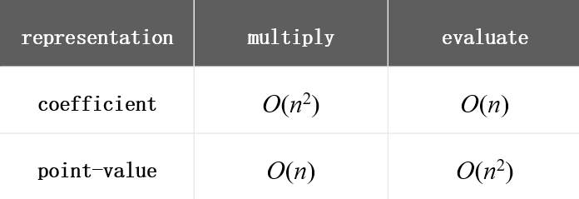
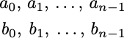
Converting between two representations
Tradeoff. Either fast evaluation or fast multiplication. We want both!
Goal. Efficient conversion between two representations ⇒ all ops fast.
coefficient representation
point-value representation

Slide 42
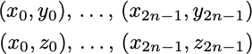
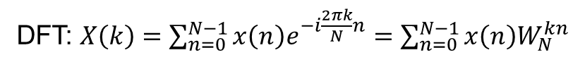
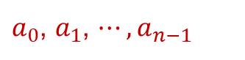
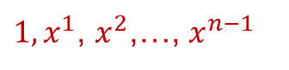
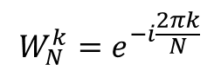
Converting between two representations
Application. Polynomial multiplication (coefficient representation).
DFT: $X\left(k\right)=\sum_{n=0}^{N−1}{x\left(n\right)e^{−i\frac{2πk}{N}n}=\sum_{n=0}^{N−1}{x\left(n\right)W_{N}^{kn}}}$
$$W_{N}^{k}=e^{−i\frac{2πk}{N}}$$
$a_{0}$, $a_{1}$, $⋯,a_{n−1}$
$1,x^{1}$, $x^{2}$,…, $x^{n−1}$
Coefficient representation
Point value representation
FFT
O(n log n)
Point-value multiplication
O(n)
Inverse FFT
O(n log n)
Coefficient representation
Point value representation

Slide 43
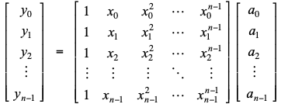
Converting between two representations: brute force
Coefficient ⇒ point-value. Given a polynomial A(x) = a₀ + a₁ x + ... + a_{n–1} x^{n–1},evaluate it at n distinct points x₀ , ..., x_{n–1}.
Running time. O(n²) via matrix–vector multiply (or n Horner’s).

Slide 44
Converting between two representations: brute force
Point-value ⇒ coefficient. Given n distinct points x₀, ... , x_{n–1} and valuesy₀, ... , y_{n–1}, find unique polynomial A(x) = a₀ + a₁ x + ... + a_{n–1} x^{n–1}, that has given values at given points.
Running time. O(n³) via Gaussian elimination.
Vandermonde matrix is invertible if xi distinct
or O(n^{2.38}) via fast matrix multiplication

Slide 45
Question 5
Which divide-and-conquer approach to use to evaluate polynomials?
Divide polynomial into low- and high-degree terms.
B. Divide polynomial into even- and odd-degree terms.
C. Either A or B.
D. Neither A nor B.
A(x) = a₀ + a₁ x + a₂ x² + a₃ x³ + a₄ x⁴ + a₅ x⁵ + a₆ x⁶ + a₇ x⁷.
A_{low}(x) = a₀ + a₁ x + a₂ x² + a₃ x³.
A_{high} (x) = a₄ + a₅ x + a₆ x² + a₇ x³.
A_{even}(x) = a₀ + a₂ x + a₄ x² + a₆ x³.
A_{odd} (x) = a₁ + a₃ x + a₅ x² + a₇ x³.

Slide 46
Divide-and-conquer
Decimation in time. Divide into even- and odd- degree terms.
A(x) = a₀ + a₁ x + a₂ x² + a₃ x³ + a₄ x⁴ + a₅ x⁵ + a₆ x⁶ + a₇ x⁷.
A_{even}(x) = a₀ + a₂ x + a₄ x² + a₆ x³.
A_{odd} (x) = a₁ + a₃ x + a₅ x² + a₇ x³.
A(x) = A_{even}(x²) + x A_{odd}(x²).
Decimation in frequency. Divide into low- and high-degree terms.
A(x) = a₀ + a₁ x + a₂ x² + a₃ x³ + a₄ x⁴ + a₅ x⁵ + a₆ x⁶ + a₇ x⁷.
A_{low}(x) = a₀ + a₁ x + a₂ x² + a₃ x³.
A_{high} (x) = a₄ + a₅ x + a₆ x² + a₇ x³.
A(x) = A_{low}(x) + x⁴ A_{high}(x).
Cooley–Tukey radix 2 FFT
Sande–Tukey radix 2 FFT

Slide 47
Coefficient to point-value representation: intuition
Coefficient ⇒ point-value. Given a polynomial A(x) = a₀ + a₁ x + ... + a_{n–1} x^{n–1},evaluate it at n distinct points x₀ , ..., x_{n–1}.
Divide. Break up polynomial into even- and odd-degree terms.
A(x) = a₀ + a₁ x + a₂ x² + a₃ x³ + a₄ x⁴ + a₅ x⁵ + a₆ x⁶ + a₇ x⁷.
A_{even}(x) = a₀ + a₂ x + a₄ x² + a₆ x³.
A_{odd} (x) = a₁ + a₃ x + a₅ x² + a₇ x³.
A(x) = A_{even}(x²) + x A_{odd}(x²).
A(−x) = A_{even}(x²) – x A_{odd}(x²).
Intuition. Choose two points to be ±1.
A( 1) = A_{even}(1) + 1 A_{odd}(1).
A(−1) = A_{even}(1) – 1 A_{odd}(1).
We get to choose which ones!
Can evaluate polynomial of degree n-1 at 2 points by evaluating two polynomials of degree ½n - 1 at only 1 point.

Slide 48
Coefficient to point-value representation: intuition
Coefficient ⇒ point-value. Given a polynomial A(x) = a₀ + a₁ x + ... + a_{n–1} x^{n–1},evaluate it at n distinct points x₀ , ..., x_{n–1}.
Divide. Break up polynomial into even- and odd-degree terms.
A(x) = a₀ + a₁ x + a₂ x² + a₃ x³ + a₄ x⁴ + a₅ x⁵ + a₆ x⁶ + a₇ x⁷.
A_{even}(x) = a₀ + a₂ x + a₄ x² + a₆ x³.
A_{odd} (x) = a₁ + a₃ x + a₅ x² + a₇ x³.
A(x) = A_{even}(x²) + x A_{odd}(x²).
A(−x) = A_{even}(x²) – x A_{odd}(x²).
Intuition. Choose two points to be ±1.
A( 1) = A_{even}(1) +1 A_{odd}(1).
A(−1) = A_{even}(1) –1 A_{odd}(1).
A( i ) = A_{even}(−1) +i A_{odd}(−1).
A( −i ) = A_{even}(−1) –i A_{odd}(−1).
We get to choose which ones!
Can evaluate polynomial of degree n-1 at 4 points by evaluating two polynomials of degree ½n - 1 at only 2 points.

Slide 49
Euler’s identity
Euler’s identity. e^{ix} = cos x + i sin x.
Sinusoids. Sum of sine and cosines = sum of complex exponentials.

Slide 50
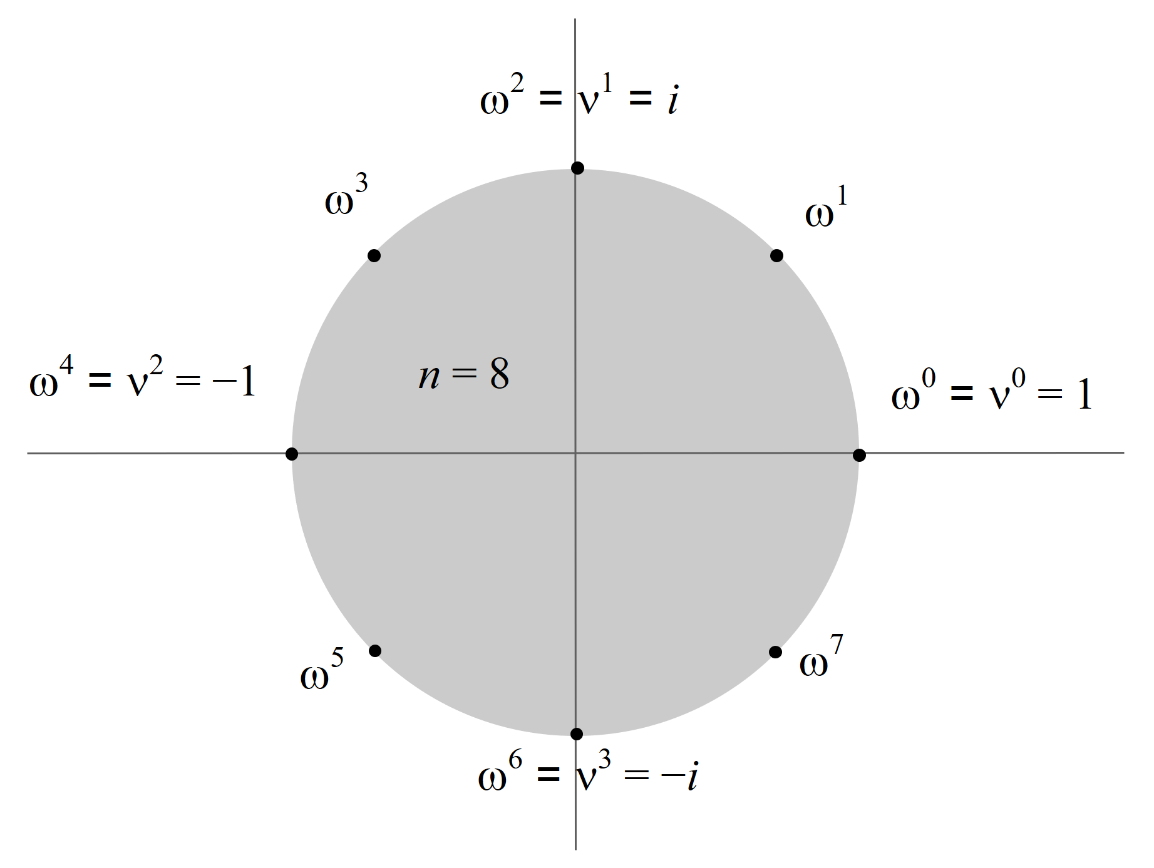
Roots of unity
Def. An n^{th} root of unity is a complex number x such that x^{n} = 1.
Fact. The n^{th} roots of unity are: ω⁰, ω¹, …, ω^{n–1} where ω = e^{2π i / n}.
Pf. (ω^{k})^{n} = (e^{2π i k / n})^{n} = (e^{π i} )^{2k} = (−1)^{2k} = 1.
Fact. The ½n^{th} roots of unity are: ν⁰, ν¹, …, ν^{n/2–1} where ν = ω² = e^{4π i / n}.
ω^{k} =−ω^{k+ ½n}

Slide 51
Fast Fourier transform
Goal. Evaluate a degree n – 1 polynomial A(x) = a₀ + ... + a_{n–1} x^{n–1} at its n^{th} roots of unity: ω⁰, ω¹, …, ω^{n–1}.
Divide. Break up polynomial into even- and odd-degree terms.
A_{even}(x) = a₀ + a₂ x + a₄ x² + … + a_{n−2} x^{n/2–1}.
A_{odd} (x) = a₁ + a₃ x + a₅ x² + … + a_{n−1} x^{n/2–1}.
A(x) = A_{even}(x²)+ x A_{odd}(x²).
A(−x) = A_{even}(x²) – x A_{odd}(x²).
Conquer. Evaluate A_{even}(x) and A_{odd}(x) at the ½n^{th} roots of unity: ν⁰, ν¹, …, ν^{n/2–1}.
Combine.
yk = A(ω^{k}) = A_{even}(ν^{k}) + ω^{k} A_{odd} (ν^{k}), 0 ≤ k < n/2.
yk+ ½n = A(ω^{k+ ½n}) = A_{even}(ν^{k}) – ω^{k} A_{odd} (ν^{k}), 0 ≤ k < n/2.
ω^{k} =−ω^{k+ ½n}

Slide 52
FFT: implementation
Goal. Evaluate a degree n – 1 polynomial A(x) = a₀ + ... + a_{n–1} x^{n–1} at its n^{th} roots of unity: ω⁰, ω¹, …, ω^{n–1}.
yk = A(ω^{k}) = A_{even}(ν^{k}) + ω^{k} A_{odd} (ν^{k}), 0 ≤ k < n/2.
yk+ ½n= A(ω^{k+ ½n}) = A_{even}(ν^{k}) – ω^{k} A_{odd} (ν^{k}), 0 ≤ k < n/2.
FFT(n, a0, a1, a2, …, an–1)
If (n = 1) Return a0.
(e0, e1, …, en/2–1) ← FFT(n / 2, a0, a2, a4, …, an–2).
(d0, d1, …, dn/2–1) ← FFT(n / 2, a1, a3, a5, …, an–1).
For k = 0 to n / 2 – 1.
ω^{k} ← e^{2π i k/n}.
yk ← ek + ω^{k} dk.
yk + n/2 ← ek – ω^{k} dk .
Return (y0, y1, y2, …, yn–1).
2 T(n / 2)
Θ(n)

Slide 53
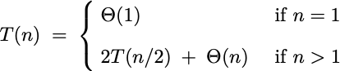
FFT: summary
Theorem. The FFT algorithm evaluates a degree n – 1 polynomial at each of the n^{th} roots of unity in O(n log n) arithmetic operations and O(n) extra space.
Pf.
Coefficient representation
O(n log n)
FFT
Point-value representation
???

Slide 54
Question 6
When computing the FFT of (a0, a1, a2, …, a7), which are the first two coefficients involved in an arithmetic operation?
A. a0 and a1.
B. a0 and a2.
C. a0 and a4.
D. a0 and a7.
E. None of the above.

Slide 55
Integer multiplication, redux
Integer multiplication. Given two n-bit integers a = a_{n–1} … a₁a₀ and b = b_{n–1} … b₁b₀, compute their product a ⋅ b.
Convolution algorithm.
Form two polynomials.
Note: a = A(2), b = B(2).
Compute C(x) = A(x) ⋅ B(x).
Evaluate C(2) = a ⋅ b.
Running time: O(n log n) floating-point operations.
Theory. [Schönhage–Strassen 1971]
O(n log² n) bit operations.
O(n log n ⋅ log log n) bit operations.
Practice. [GNU Multiple Precision Arithmetic Library] Switches to FFT-based algorithm when n is large (≥ 5–10K).
FFT over complex numbers; need O(log n) bits of precision
FFT over ring of integers (modulo a Fermat number)

Slide 56
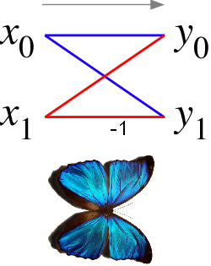

FFT Butterfly
Ref: http://en.wikipedia.org/wiki/Butterfly_diagram

Slide 57

Sande–Tukey radix 2 FFT Butterfly

